Slide 1
What’s new with: “Using the USGS ‘Resource for Advanced Modeling’ to connect climate drivers to biological responses”
Jeff Morisette, and many others
NASA Biodiversity Team meeting April 23-25, 2013
Notes:
Student presentation/poster judge
Attending interdisciplinary session on art and science
Explain ReVAMP
Alternate title: “What happened to the promise of NASA’s Earth Observing System?: are we fully utilizing remote sensing products for climate science?”
Your not the director of USGS and Paul’s not the director of DEVELOP?
There will be an oral session (Wed morning G31l and poster session G33E.

Slide 2
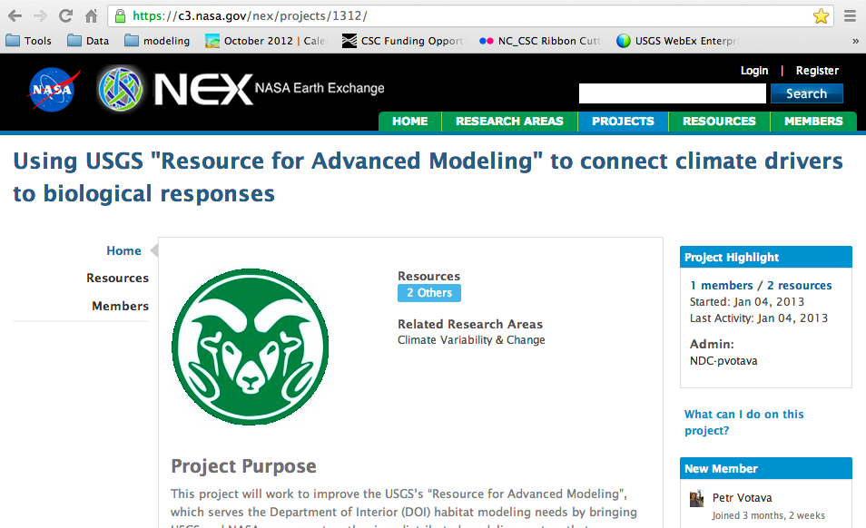

Slide 3
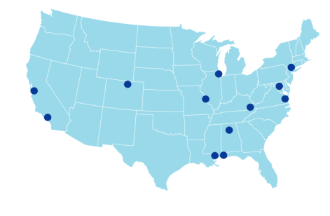
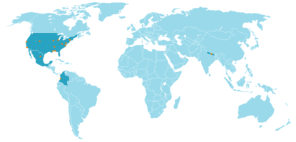
Catherine Jarnevich
Tracy Holcombe
Colin Talbert
Marian Talbert
USGS-CSU
Resource for
Advanced Modeling
Sunil Kumar
Cam Aldridge
Tom Stohlgren
Dennis Ojima
Tom Hilinski
David Koop
Claudio Silva
David Blodgett
Emily Fort
Robin O’Malley
Shawn Carter
Doug Beard
Petr Votava
Rama Nemani
Paul Evangelista

Slide 4
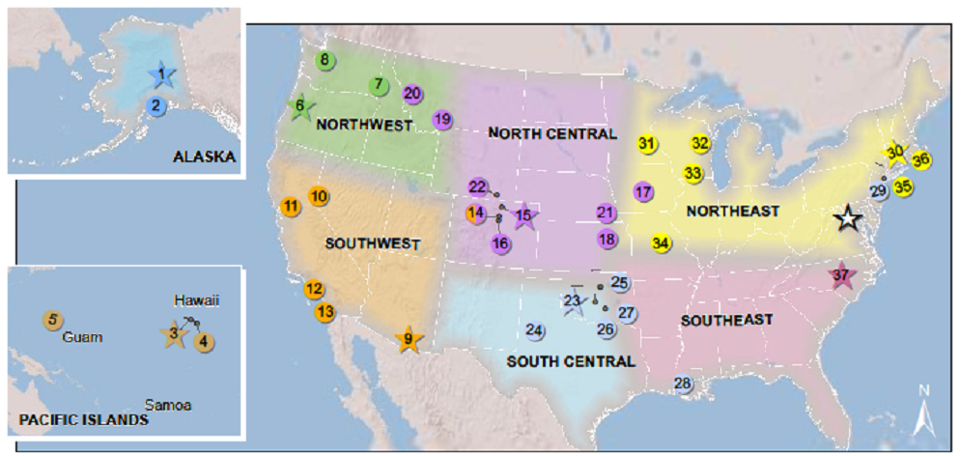
DOI Climate Science Centers
Notes:
2010: Alask, Northwest, Southeast
2011: Southwest and North Central
2012: Pacific, South Central, Northeast
Regions have “fuzzy boundaries” to accommodate biological realities and not be tied to a single geographic frame
No single set of lines will work for every conservation challenge
Climate change will have large regional expression, and the regions here will face common changes and resource conditions.
Our goal is to not let them get in the way of doing business.

Slide 5
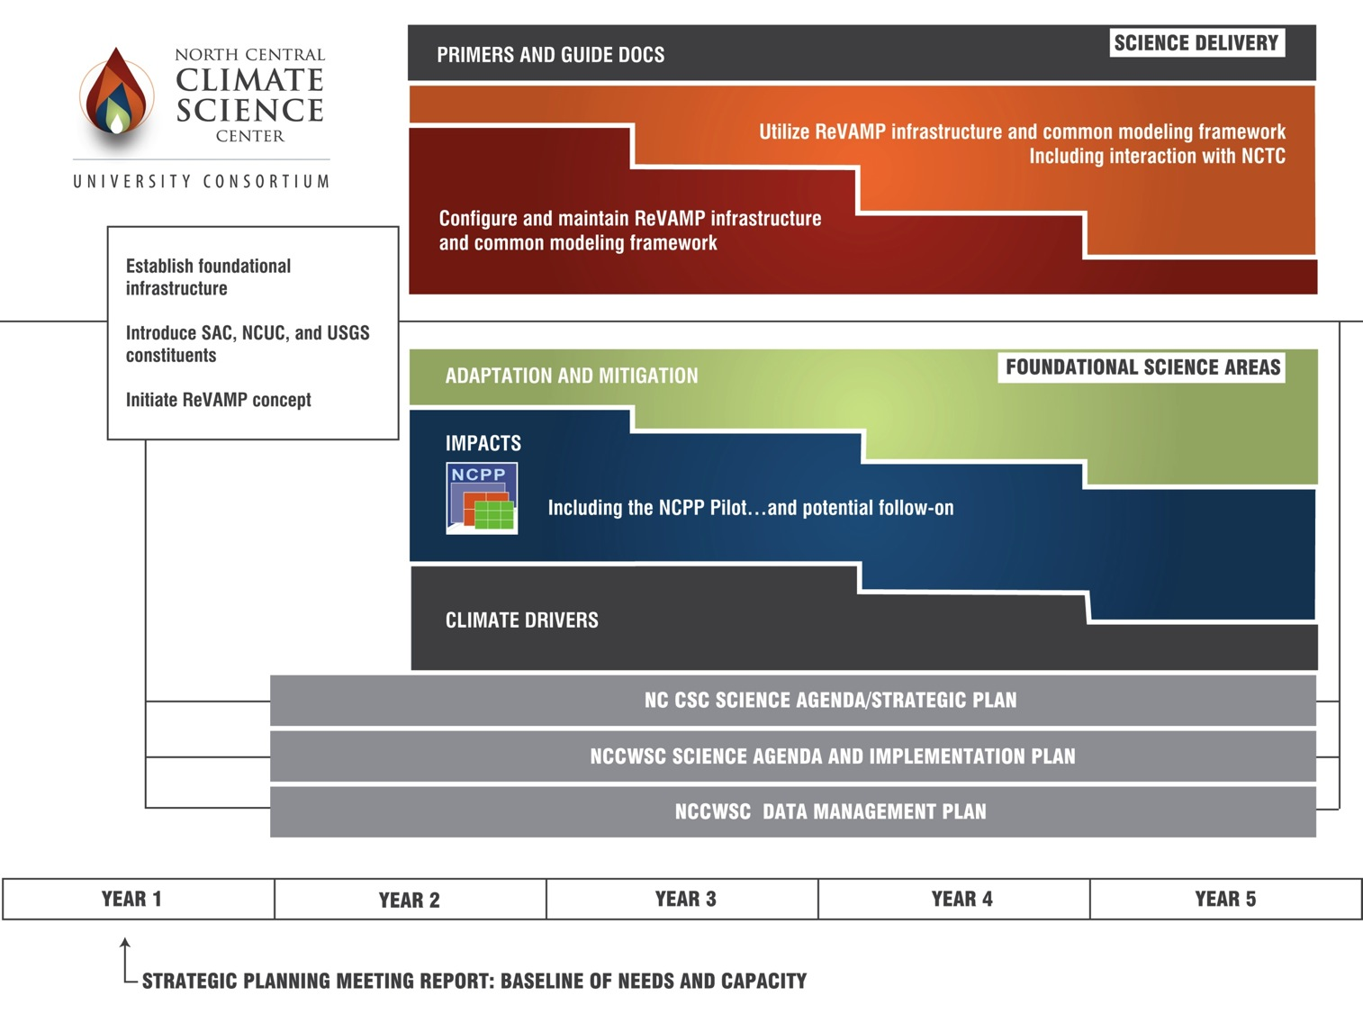
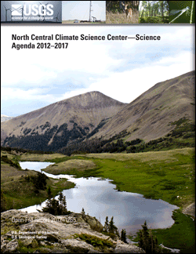
Available on-line at http://pubs.usgs.gov/of/2012/1265/
Notes:
Strategic Science through ReVAMP: a Resource for Vulnerability Assessment, Adapation, and Mitigation Planning

Slide 6
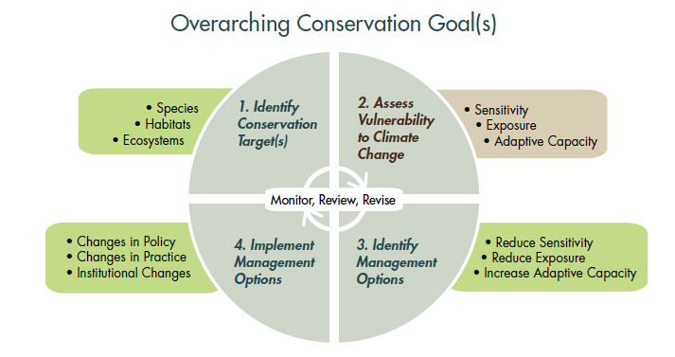
NCUC & USGS centers
LCCs, Tribes and
Other stakeholders
Glick, P., B.A. Stein, and N.A. Edelson, editors. 2011. Scanning the Conservation Horizon: A Guide to Climate Change Vulnerability Assessment. National Wildlife Federation, Washington, D.C.
Notes:
Closely aligned to those of the NC CSC.
Provides an accessible and logical approach for incorporating climate science into land management through vulnerability assessments.
Follows international standards for vulnerability assessment (IPCC 2007).
Builds on existing and established conservation planning frameworks, such as those of The Nature Conservancy and U.S. Fish and Wildlife Service.
Can be used to highlight the roles within a vulnerability assessment where the SAC, NCUC, and USGS centers provide the most expertise.
The primary text for DOI Training on climate change vulnerability assessments.

Slide 7
Work funded through 2013 solicitation
Specific Decision Process:
to utilize NC CSC science & use the R.A.M.
Resources and capacity being built and available through the NC CSC.
Notes:
Strategic Science through ReVAMP: a Resource for Vulnerability Assessment, Adapation, and Mitigation Planning

Slide 8
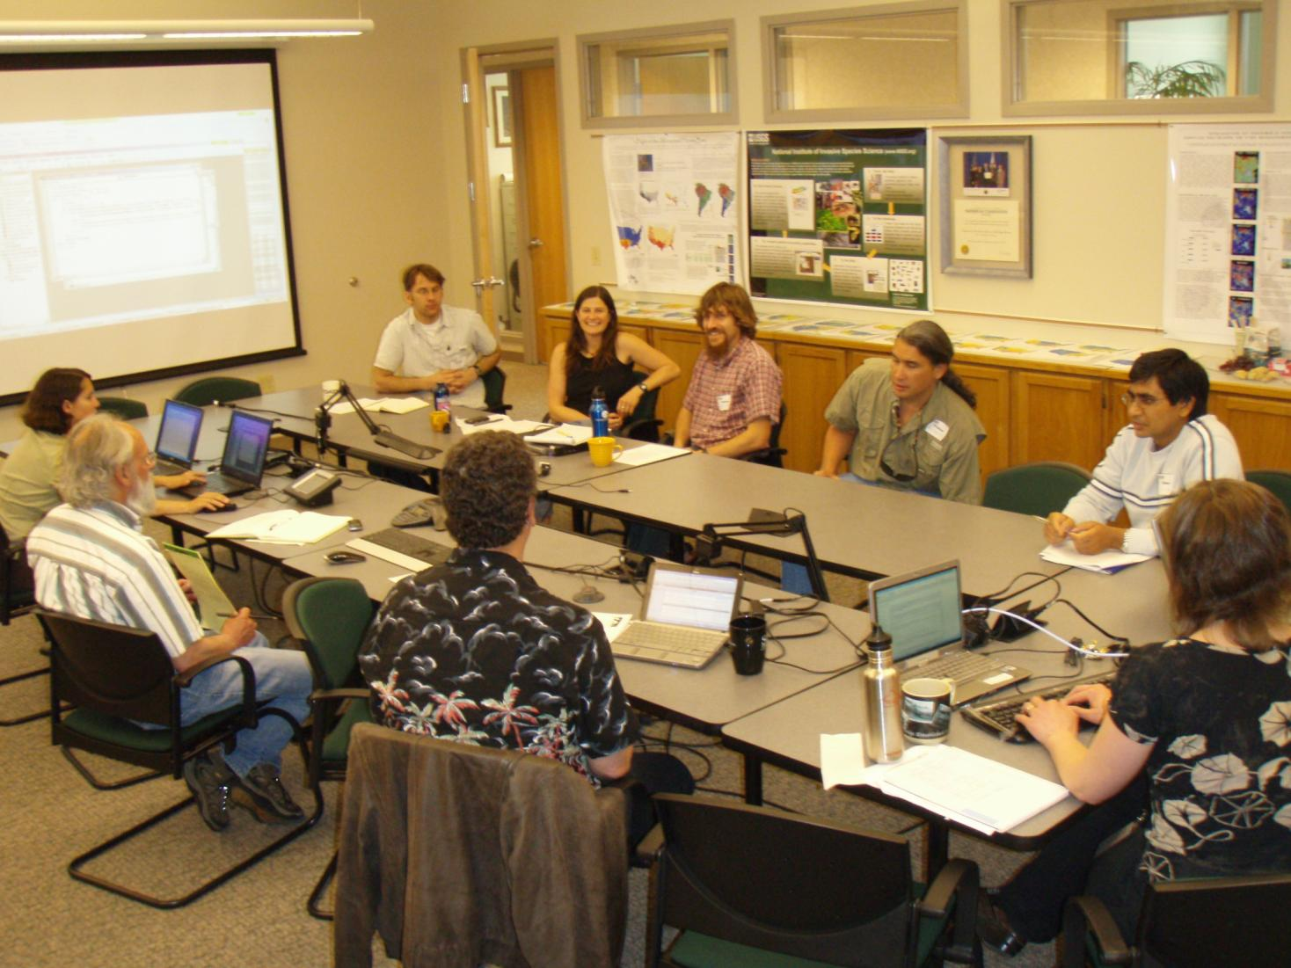
RAM: Collaboration on climate vulnerability assessment…
A team approach (including land managers and climate, ecological, and social science experts)
Easy access to a full suite of climate data
Transparency on input data and modeling procedure
Visual output to reveal climate contribution to ecological model and/or management simulation results
Ability to quickly explore “what if” scenarios

Slide 9
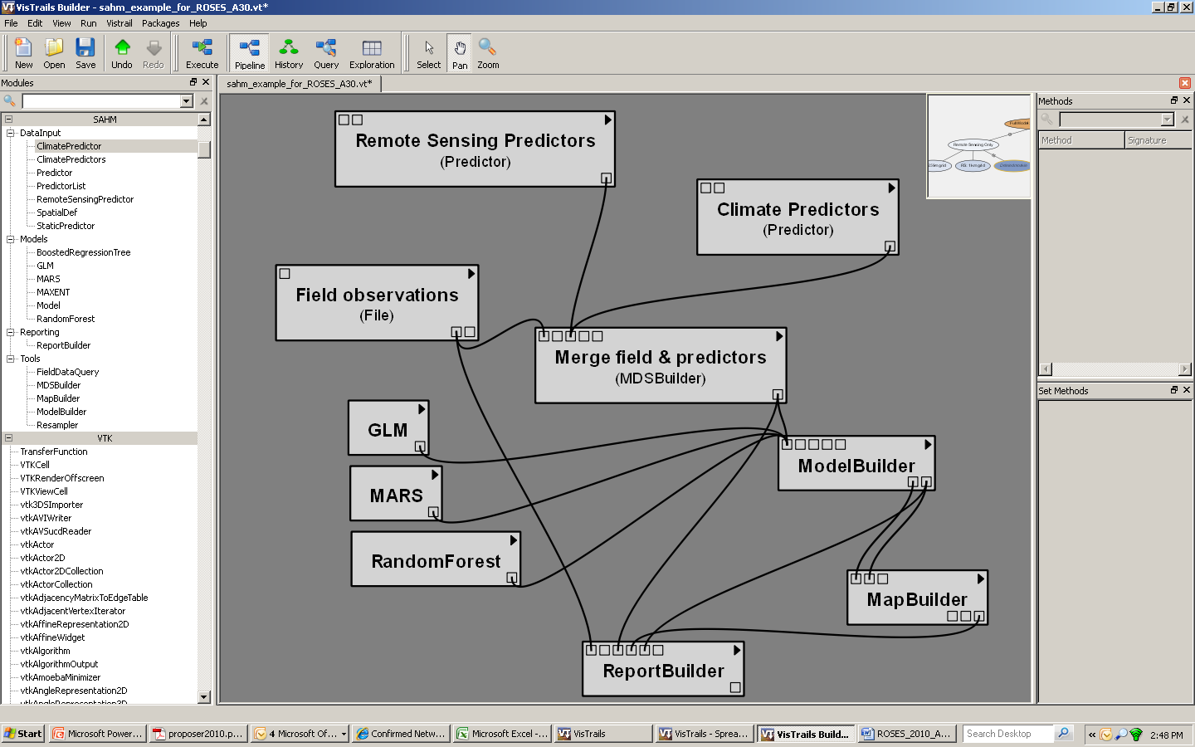
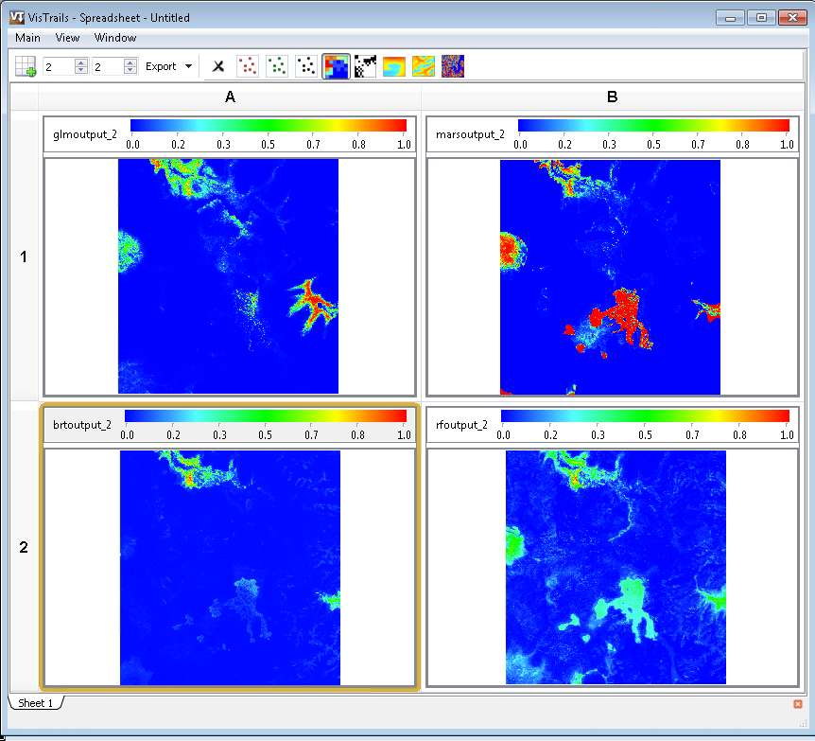
…making our modeling transparent and repeatable.
Morisette et al., 2013. VisTrails SAHM: visualization and workflow management for species habitat modeling. Ecography 36: 129–135. doi: 10.1111/j.1600-0587.2012.07815.x

Slide 10
What Would a Model Web Look Like?
Climate
Socioeconomic
Fire
Risk
Frequency
Intensity
Behavior
Emissions
Landscape
Ecotype
Tree density
Biomass
Disturbance
Succession
Composition
Biogeochemical
Local / landscape
water & energy
balance
Carbon
Accounting
Sequestration
Allocation
Flows
Public Health
Vector distribution and abundance
Deforestation
Population density
Behavior
Education
Countermeasures
Etc
Species
distribution
Invasive species
Ecosystem
Services
Public health

Slide 11
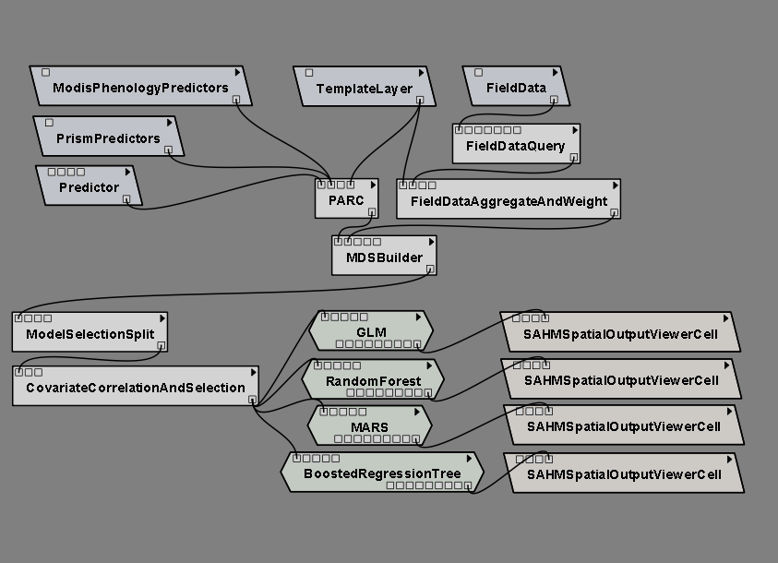
Input data
Preprocessing
Preliminary model analysis & decision
Correlative models
Output routines

Slide 12
Input
Predictor layers: Using machine services to grab data from USGS GeoDataPortal and LP DAAC
Species Observations: USGS BISON
Forecasting
Exploring the use of DayCent model output for vegetation and Soil conditions.
Looking to use the Ames CMIP-5, 800m data via NASA Center for Climate Simulations
Input data
Preprocessing
Preliminary model analysis & decision
Correlative models
Output routines

Slide 13
Input data
Distributing compute jobs: - currently down from days to hours,
- looking to get from hours to minutes
Preprocessing
Preliminary model analysis & decision
Correlative models
Output routines

Slide 14
Input data
Preprocessing
Modeling routines
currently handles presence only, and presence-absence.
exploring abundance, and spatial-temporal data (e.g. GPS tracking or satellite telemetry)
Preliminary model analysis & decision
Correlative models
Output routines

Slide 15
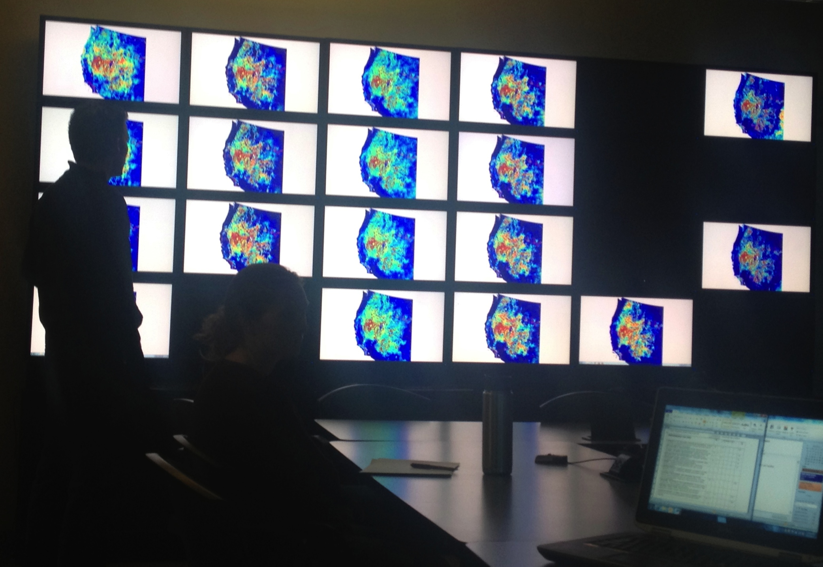
Input data
Preprocessing
VisWall:
24 (6x4) array of 27” monitors
And
“Standard” VisTrail Spreadsheet output
Preliminary model analysis & decision
Correlative models
Output routines

Slide 16
Input
Predictor layers: Using machine services to grab data from USGS GeoDataPortal and LP DAAC
Species Observations: USGS BISON
Forecasting
Exploring the use of DayCent model output for vegetation and Soil conditions.
Looking to use the Ames CMIP-5, 800m data via NASA Center for Climate Simulations
Input data
Preprocessing
Preliminary model analysis & decision
Correlative models
Output routines

Slide 17
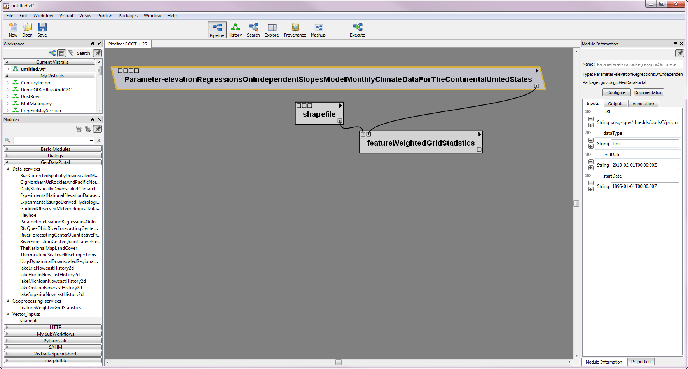
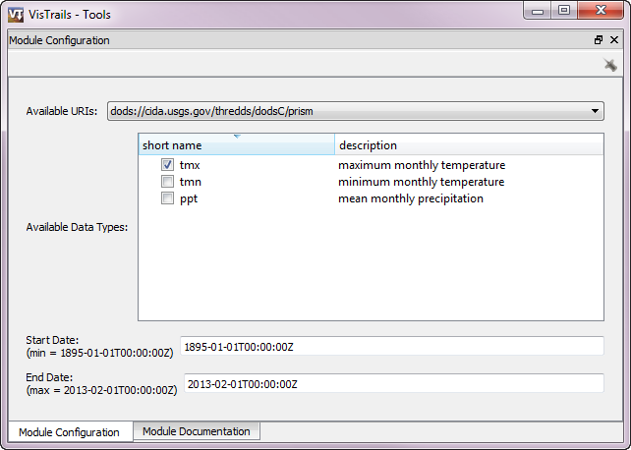
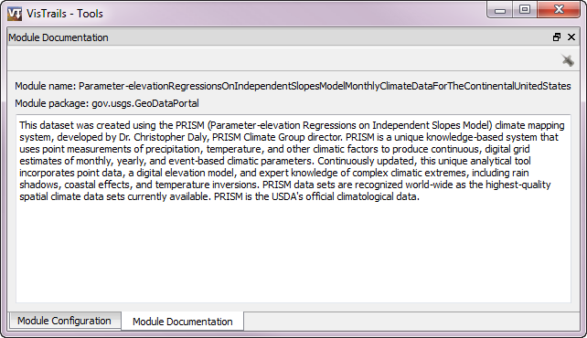
VisTrails User Interface
Dynamically generated modules for each service
User friendly interaction
Built in documentation
Notes:
Dynamic list is generated from CIDA. The shapefile gets uploaded to GDP,

Slide 18
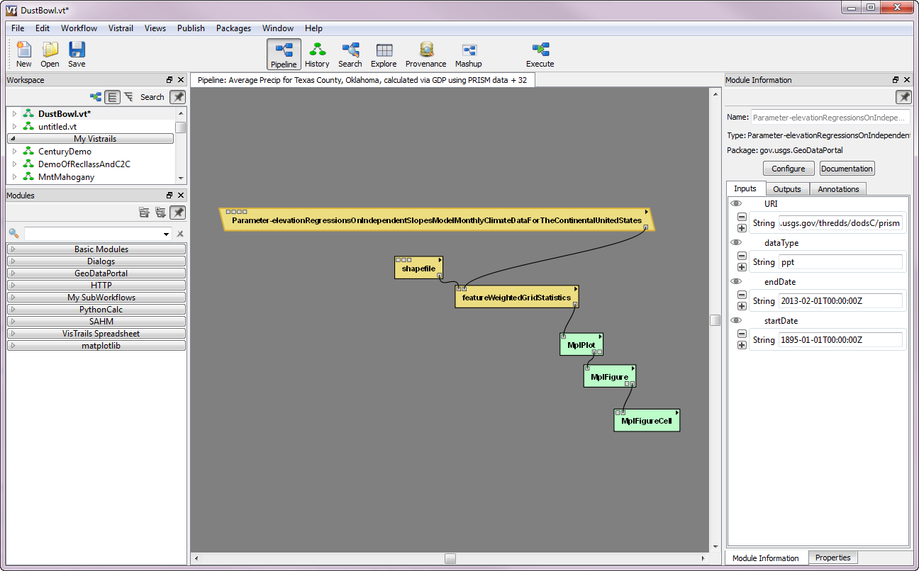
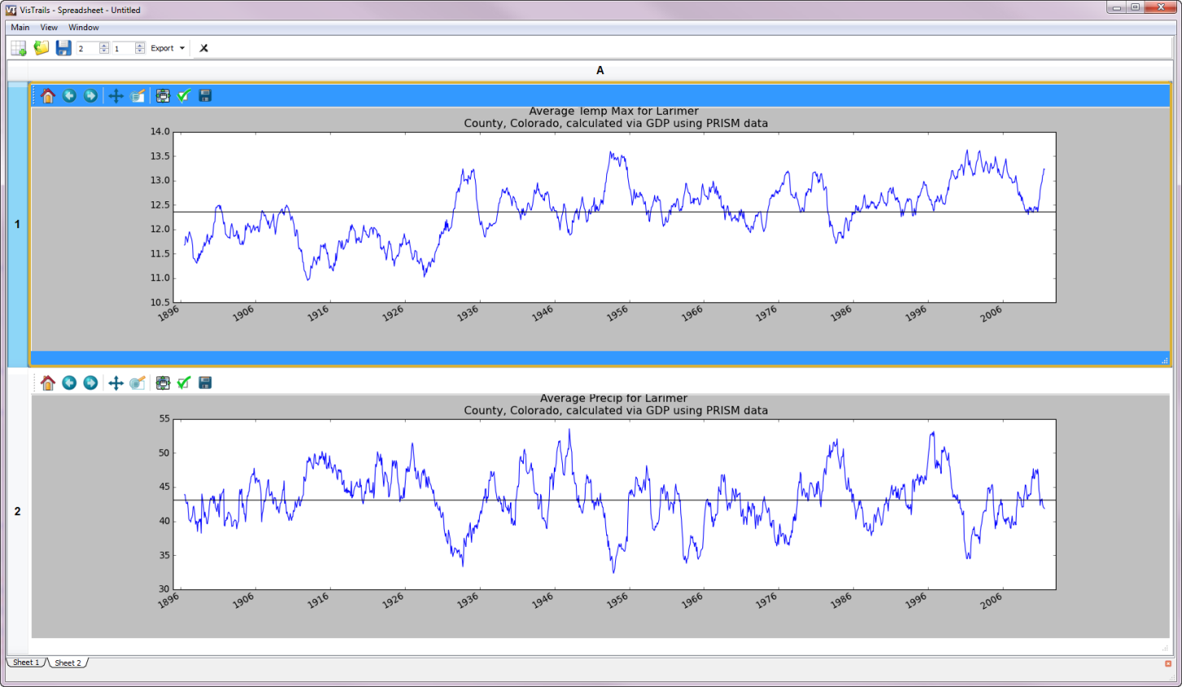
VisTrails Workflow example:
Maximum monthly temp for Larimer County, CO
Mean monthly Precipitation for Larimer County, CO
Notes:
NC CSC is able to access data from the USGS GeoDataPortal through their THREDDS (Thematic Realtime Environmental Distributed Data Services)/OPeNDAP (Open-source Project for a Network Data Access Protocol) server.

Slide 19
Consuming USGS Geo Data Portal Services in VisTrails
Seamless delivery of large or cumbersome data to
researchers and managers
Ability to use and summarize THREDDS data from a variety
of sources such as CIDA, ORNL, NOAA, and EROS.
Customizable user interface for Geo Data Portal functionality
Provenance, workflow and visualization capabilities
provided through VisTrails
Integration with other modeling packages such as
the Software for Assisted Habitat Modeling (SAHM)
Future integration with other online data sources such as
ScienceBase, BISON, and others
Technical issues remain, and will likely persist; but this could allow remarkable efficiencies when considering the various climate models, updated versions of those models, multiple emissions scenarios, downscaling techniques, and increases in spatial and temporal resolutions.

Slide 20
Input data
Distributing compute jobs: - currently down from days to hours,
- looking to get from hours to minutes
Preprocessing
Preliminary model analysis & decision
Correlative models
Output routines

Slide 21
Notes:
Major challenge is to parallelize ecological response modeling code
LP DAAC has ~1PB

Slide 22
Input data
Preprocessing
VisWall:
24 (6x4) array of 27” monitors
And
“Standard” VisTrail Spreadsheet output
Preliminary model analysis & decision
Correlative models
Output routines

Slide 23
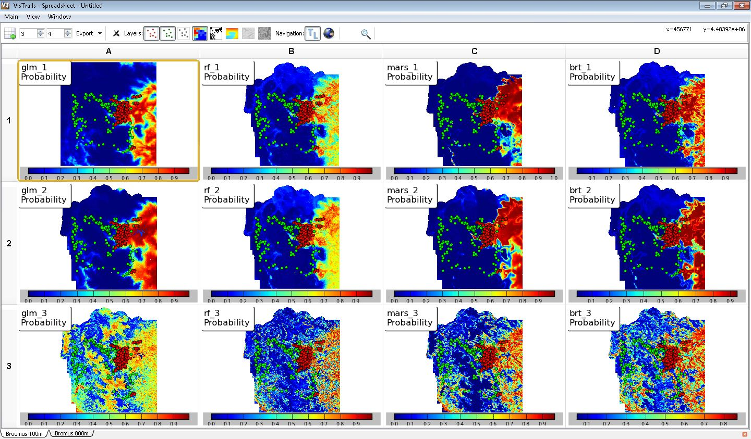
Cheatgrass habitat in Rocky Mountain National Park
Climate & Remote Sensing
No Remote Sensing
No Climate
Generalized Linear Model
Random Forest
Multivariate Adaptive Regression Splines
Boosted Regression
Tree

Slide 24
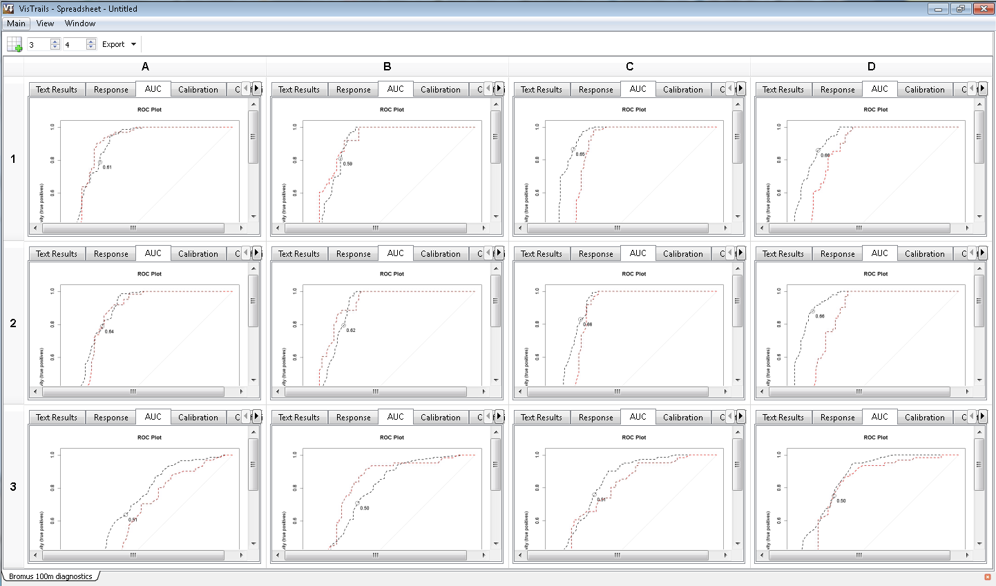
Cheatgrass habitat in Rocky Mountain National Park
Climate & Remote Sensing
0.890
0.892
0.890
0.902
0.939
0.849
0.939
0.859
No Remote Sensing
0.876
0.856
0.878
0.898
0.904
0.848
0.957
0.856
0.707
0.613
0.771
0.811
0.837
0.784
0.859
0.801
No Climate
Generalized Linear Model
Random Forest
Multivariate Adaptive Regression Splines
Boosted Regression
Tree

Slide 25
Comprehensive provenance infrastructure (detailed history information on the steps followed and data derived in the course of an exploratory task, making all finding repeatable, important for FOYA, IQA, other court issues).
First released in January 2007, VisTrails 2.0 was released in 2012
The system has been downloaded over 35,000 times.
VisTrails wiki has had over 1.5 million page views
Google Analytics reports visitors from 65 different countries.
VisTrails has been adopted in:
Ocean Sciences (Baptista, et al. 2008, Howe, et al. 2008),
Psychiatry (Anderson, et al. 2007),
Astronomy (Tohline, et al. 2009),
Cosmology (Anderson, et al. 2008),
High-Energy Physics (Dolgert, et al. 2008), and
Quantum physics (Bauer, et al. 2011, Freedman, et al. 2012).
Ultrascale Visualization - Climate Data Analysis Tools (UV-CDAT) <http://uv-cdat.llnl.gov>.
VisTrails works through a graphical user interface where the user pulls pre-defined modules.
Freire, J., et al. 2006. Managing Rapidly-Evolving Scientific Workflows. - In: L. Moreau and I. Foster (eds), Springer Berlin / Heidelberg, pp. 10-18.
Freire, J. and Silva, C. T. 2012. Making Computations and Publications Reproducible with VisTrails. - Computing in Science & Engineering 14: 18-25
Notes:
Citation from slide:
Anderson, E. W., et al. 2007. Towards Development of a Circuit Based Treatment for Impaired Memory: A Multidisciplinary Approach. - In: Neural Engineering, 2007. CNE '07. 3rd International IEEE/EMBS Conference on. pp. 302-305.
Anderson, E. W., et al. 2008. Provenance in Comparative Analysis: A Study in Cosmology. - Computing in Science & Engineering 10: 30-37.
Baptista, A., et al. 2008. Scientific Exploration in the Era of Ocean Observatories. - Computing in Science and Engineering 10: 53-58.
Bauer, B., et al. 2011. The ALPS project release 2.0: open source software for strongly correlated systems. - Journal of Statistical Mechanics: Theory and Experiment 2011: P05001.
Dolgert, A., et al. 2008. Provenance in High-Energy Physics Workflows. - Computing in Science & Engineering 10: 22-29.
Freedman, M. H., et al. 2012. Galois conjugates of topological phases. - Physical Review B 85: 045414.
Howe, B., et al. 2008. End-to-End eScience: Integrating Workflow, Query, Visualization, and Provenance at an Ocean Observatory. - In: eScience, 2008. eScience '08. IEEE Fourth International Conference on eScience. pp. 127-134.
Tohline, J. E., et al. 2009. A Customized Python Module for CFD Flow Analysis within VisTrails. - Computing in Science & Engineering 11: 68-73.

